Slide 1
SmartBudget_Presentation
UBCO Master of Data Science – DATA 533

Slide 2
SmartBudget Project
Group Members:
- Student Chongwen(Peter) Sun
- Student Yifu Zhao
- Student Cho Wing Chan

Slide 3
Project Overview
SmartBudget is a lightweight Python package for managing household finances.
It lets users add income and expense records, save, load and clean data in JSON format, and generate
basic financial summaries. The package demonstrates，modularprogramming, OOP design, and practical data handling

Slide 4
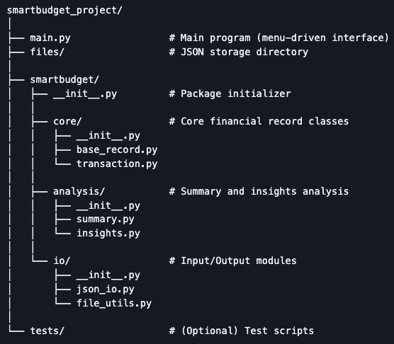
Package Structure
It contains four sub-packages:
1. entity – Defines data models
Includes a RecordBase superclass, with Income and Expense inheriting and adding type_x0002_specific fields.
2. analysis – Performs calculations
Functions compute total income, expenses, and net balance, and generate simple summary details.
3. io – Manages storage
Supports saving, cleaning, loading, and appending JSON data, plus listing or deleting files.
4. core – Provides application logic
Controllers handle record creati

Slide 5
Core Package
The core package defines the foundational data structures for all financial records in the system.
It ensures consistent data behavior through object inheritance.

Slide 6
Core Package——Module: base_record
Class: RecordBase
Serves as a minimal, shared template for all financial records by storing a record’s name and numeric amount, and providing basic display, validation, and serialization behaviour.
Key Methods:
show() – Returns a formatted string combining the record name and amount for display.
is_positive() – Checks whether the stored amount is positive, which helps distinguish income-like values.
to_dict() – Converts the record into a simple dictionary so it can be saved or transferred by other parts of the system.

Slide 7
Core Package——Module: transaction
Class: Income
Represents money coming into the budget, always stores the amount as a positive value, and adds a “source” field so users can see where the income comes from.
Key Methods:
yearly_income() – Projects the monthly income to an annual amount for long-term planning.
describe() – Generates a human-readable sentence summarizing the income and its source.
to_dict() – Exports the income record, including its source and type, in a structured format for storage and analysis.

Slide 8
Core Package——Module: transaction
Class: Expense
Represents money going out of the budget, automatically stores the amount as a negative value, and tags each expense with a “category” so spending patterns can be analyzed.
Key Methods:
yearly_cost() – Projects the monthly expense to an annual cost to show long-term impact.
describe() – Generates a human-readable sentence summarizing the expense and its category.
to_dict() – Exports the expense record, including its category and type, in a structured format for storage and analysis.

Slide 9
Analysis Package
The analysis package is responsible for turning raw income and expense records into useful financial summaries and insights that help users understand their household budget.

Slide 10
Analysis Package——Module: summary
Function: total_income(incomes)
Calculates the total amount of all recorded income entries to show how much money is coming in.
Function: total_expenses(expenses)
Calculates the total amount of all recorded expenses, preserving negative values to reflect money going out.
Function: budget_balance(incomes, expenses)
Combines total income and total expenses to produce the final budget balance, showing whether the user has a surplus or deficit.

Slide 11
Analysis Package——Module: insights
Function: expense_details(expenses)
Generates readable text descriptions for each expense so users can easily review their spending history.
Function: income_details(incomes)
Generates readable text descriptions for each income record so users can easily review their earning history.
Function: largest_expenses(expenses, n=3)
Identifies and returns the top largest expenses based on absolute value, helping users spot major spending areas.

Slide 12
Analysis Package——Module: insights
Function: largest_incomes(incomes, n=3)
Identifies and returns the top largest income sources in descending order, helping users see their main income streams.
Function: print_records(title, records)
Displays a clean, formatted list of records under a given title to improve readability of output.

Slide 13
IO Package
The I/O package handles persistent data storage and file operations for the SmartBudget system.
It allows users to save their financial data and reload it later.
All data files are managed inside a dedicated storage folder.

Slide 14
IO Package——Module: json_io
Function: save_to_json(records, filename)
Converts income and expense records into a structured JSON format and saves them as a file in the system’s storage directory.
Function: load_from_json(filename)
Loads a JSON file from storage and reconstructs financial records back into usable objects.

Slide 15
IO Package——Module: file_utils
Function: file_exists(filename)
Checks whether a specific data file already exists to prevent overwriting or loading errors.
Function: delete_file(filename)
Removes a selected data file from the storage directory to help users manage their saved data.
Function: list_files()
Displays all available saved data files so users can easily choose what to load or delete.

Slide 16
Main Application
Program Purpose
The main program serves as the user-facing interface of SmartBudget and connects all sub-packages into a complete workflow.
It allows users to interact with the system through a menu-based interface.
Data Management
Stores income and expense records in separate in-memory collections during program execution.
Supports dynamic creation and updating of financial records.
Menu Control
Displays a structured menu that allows users to select system functions.
Controls the program execution loop and coordinates function calls based on user input.

Slide 17
DEMO
Using 4 short demo, I will show how users can add records, view summaries, save data, and manage files through the SmartBudget system.

Slide 18
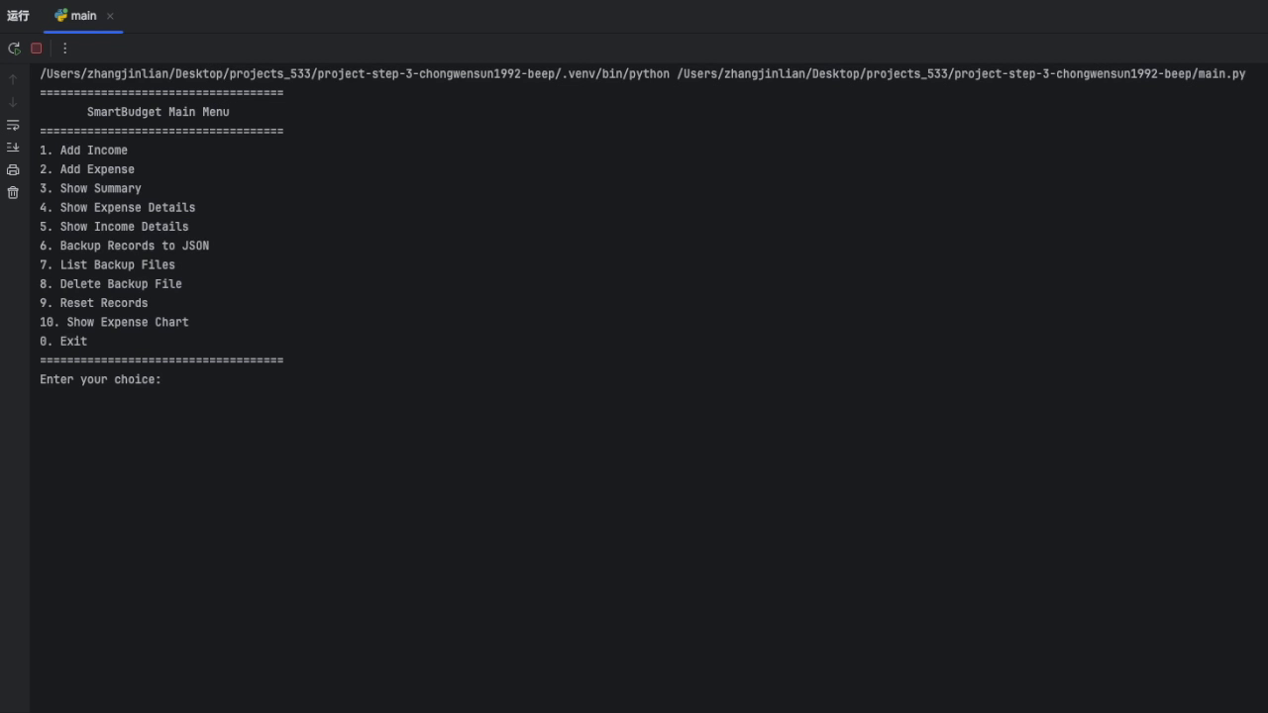
DEMO——Core Record Operations

Slide 19
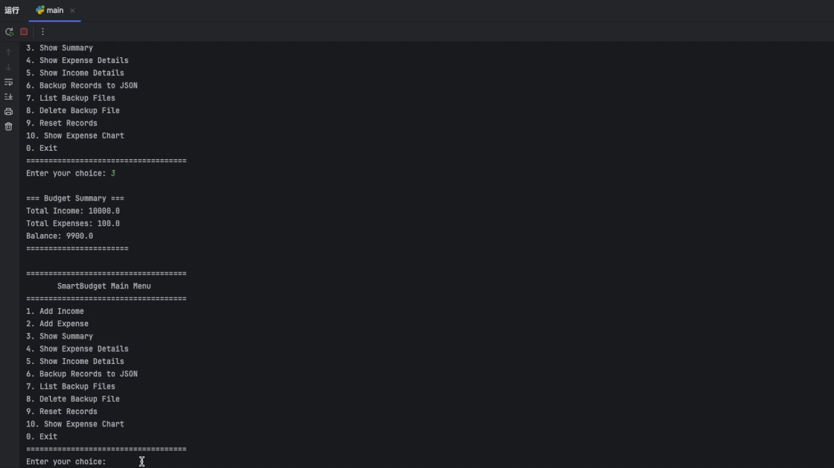
DEMO--Reporting and Visualization Modules

Slide 20
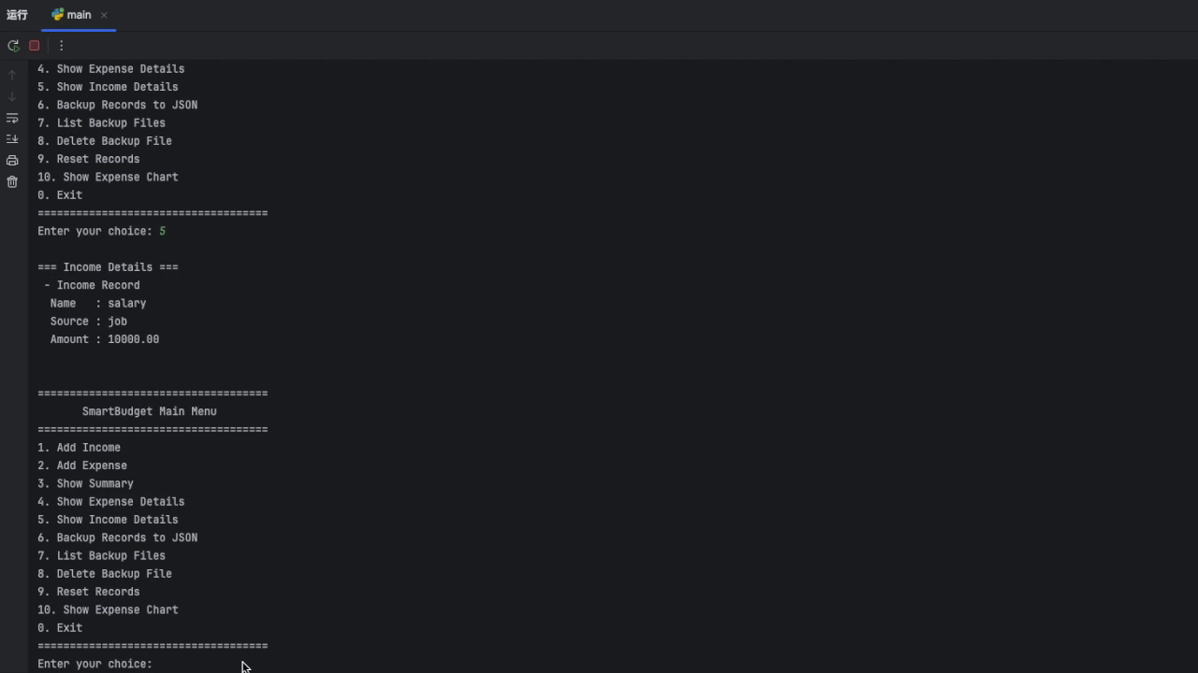
DEMO——Data Management and System Maintenance

Slide 21
Conclusion
SmartBudget provides:
A complete class hierarchy for financial records.
Summary and insight analysis functions.
JSON-based persistence.
File management utilities.
A menu-driven main application.
This fulfills all requirements for the project and demonstrates professional package design.

Slide 22
Thank you!

